Slide 1
QXU4004 Engineering Chemistry
Dr Sulafudin Vukusic s.vukusic@qmul.ac.uk

Slide 2
QXU4004 Engineering Chemistry
Amines, Carboxylic Acids and Derivatives
Suggested Reading List:
Chapters 19, 20, 22: “Organic Chemistry” by Francis A. Carey & Robert M. Giuliano (10th Edition, McGraw-Hill Education, 2017).

Slide 3
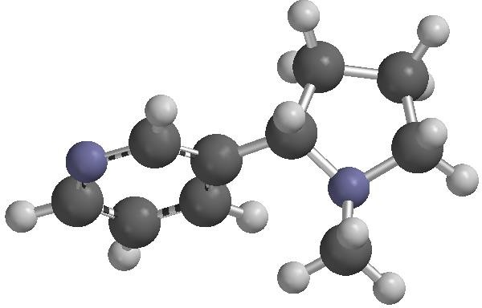
Amines
3

Slide 4






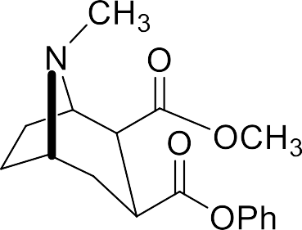
Examples of amines
4

Slide 5
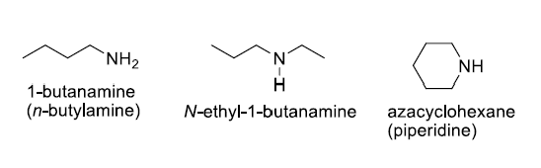
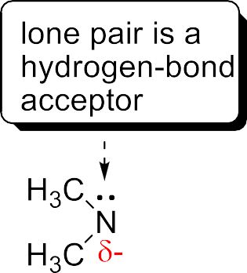
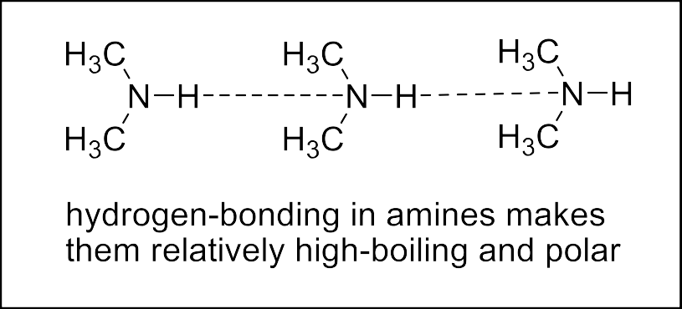
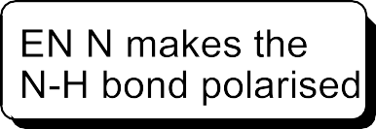
Nomenclature and properties
1º - Longest chain (containing the
N) is named with the suffix - amine (simple molecules) or - amino (complex structures)
2º, 3º – named as N-alkyl- or N,N- dialkyl- derivatives of 1º
Cyclic amines (N in ring)- named as aza-cycloalkane
5

Slide 6


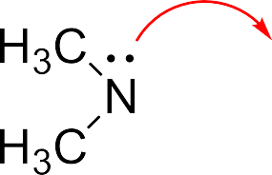


Basicity
The lone pair can be used to bond (reversibly) to H⁺
So, amines are moderate/good bases
Typical pK_{a} values are shown
Note: pK_{a} refers to the acidity of the conjugate acid (BH⁺)
Moderate pK_{a} for BH⁺ means moderate base strength
Compound | pK_{a}
Ammonia | 9.26
Methylamine | 10.64
Trimethylamine | 9.79
Ethoxide (NaOEt) | Ca. 18
Carbonate (CO₃²⁻) | 10.25
[B][H ⁺ ]
^{Ka =} [BH ⁺ ]
pK_{a} = − log K_{a}
6

Slide 7
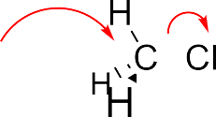
















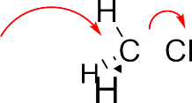





Reactions: amine as nucleophile
The lone pair can be used to displace a
leaving group (S_{N}2)
BUT, the lone pair can be regained by loss of H⁺
By using a base stronger than amine (e.g. hydroxide)
The lone pair in product means that it (a more substituted amine) is also a nucleophile
So, it may react further until no ‘H’ is left on
the N
This is also why amines form amides by reacting together with other carboxylic acid derivatives (but NOT with carboxylic acids themselves, WHY?)
7

Slide 8
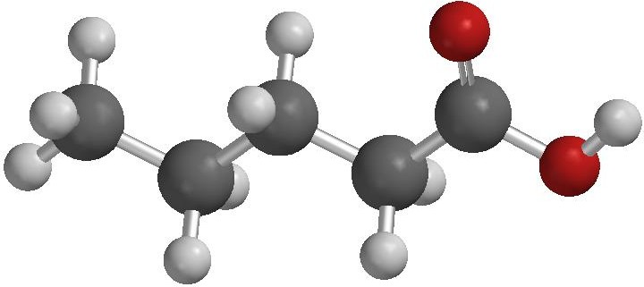
Carboxylic acids and derivatives
8

Slide 9
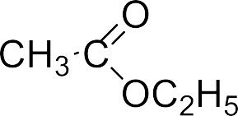
























Functional groups: carboxylic acids, esters, acyl chlorides, amides
Esters and amides are VERY important type of polymers
Carboxylic acid
Ester
Acyl chloride (or acid chloride)
Carboxylic acid
Ester
Amide
9

Slide 10
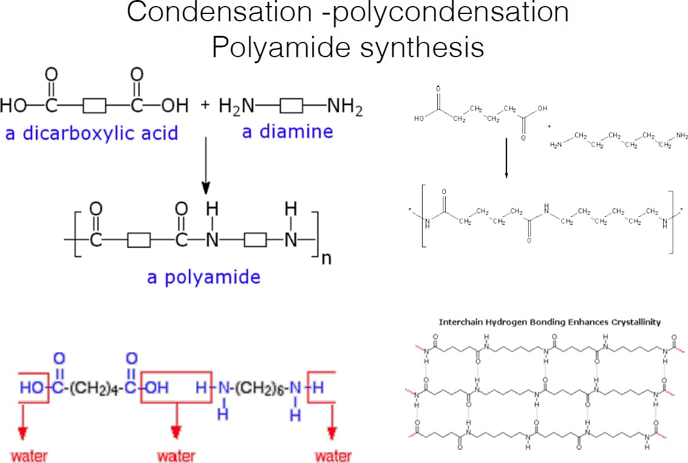
Polyesters and polyamides are VERY important type of polymers

Slide 11
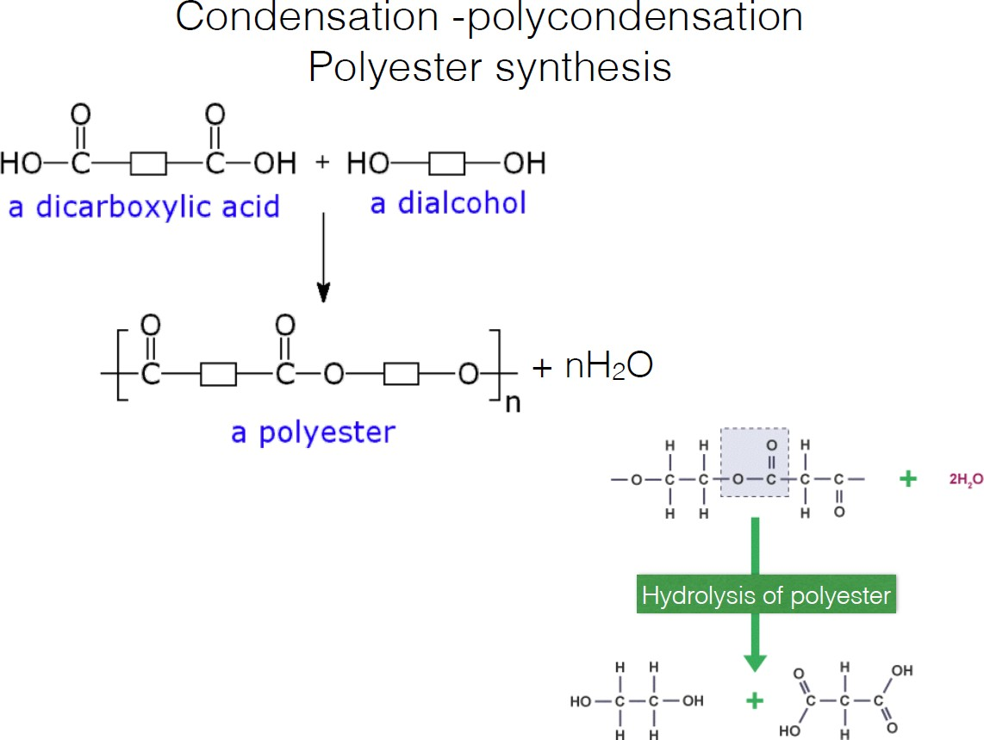
Polyesters and polyamides are VERY important type of polymers

Slide 12
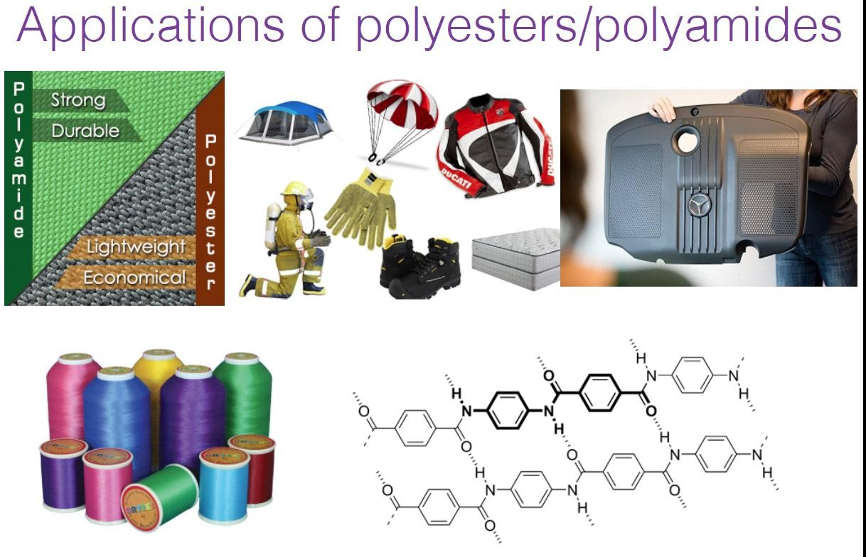
Polyesters and polyamides are VERY important type of polymers
Polymeric fibres: commonly (but not always) polyesters or polyamides
polyesters or polyamides
Polyamide
Polyester (fibres)
Polyamide (Kevlar)

Slide 13
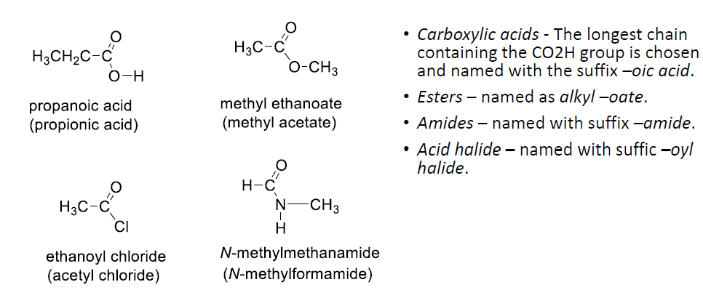
Nomenclature

Slide 14
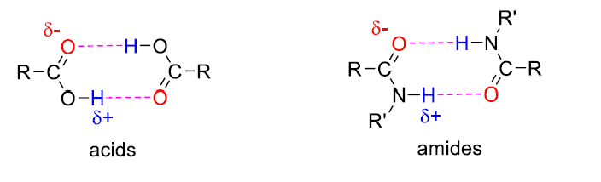
Physical properties
The acids can hydrogen bond to one-another and so tend to be relatively polar high
boiling liquids
The polarity, and the hydrophilicity decreases as the alkyl chain increases.
Amides can also hydrogen bond and are relatively polar high boiling liquids or solids
Esters and chlorides are less polar and are hydrophobic

Slide 15
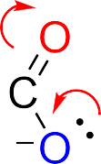
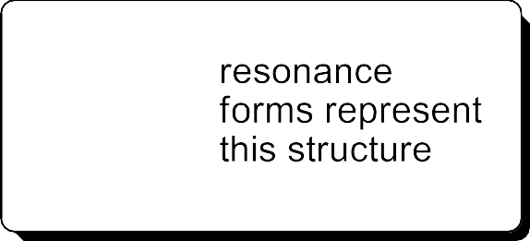
Acidity of carboxylic acids
The acidity arises because when the H⁺ is ‘lost’ the remaining anion (conjugate base) can stabilise the anion by resonance delocalisation.
pKa
-7
HCl
Moderate K_{a} and moderate (+) pK_{a} means moderate acid
Moderate acid means moderate conjugate base
− +
₌ [ A ][H ]
Cl C CO H
0.64
K
3
2
a
[HA]
CH₃ CO₂H
4.7
pK = − log K
CO₂H
4.2
a
a
CH₃OH
16

Slide 16


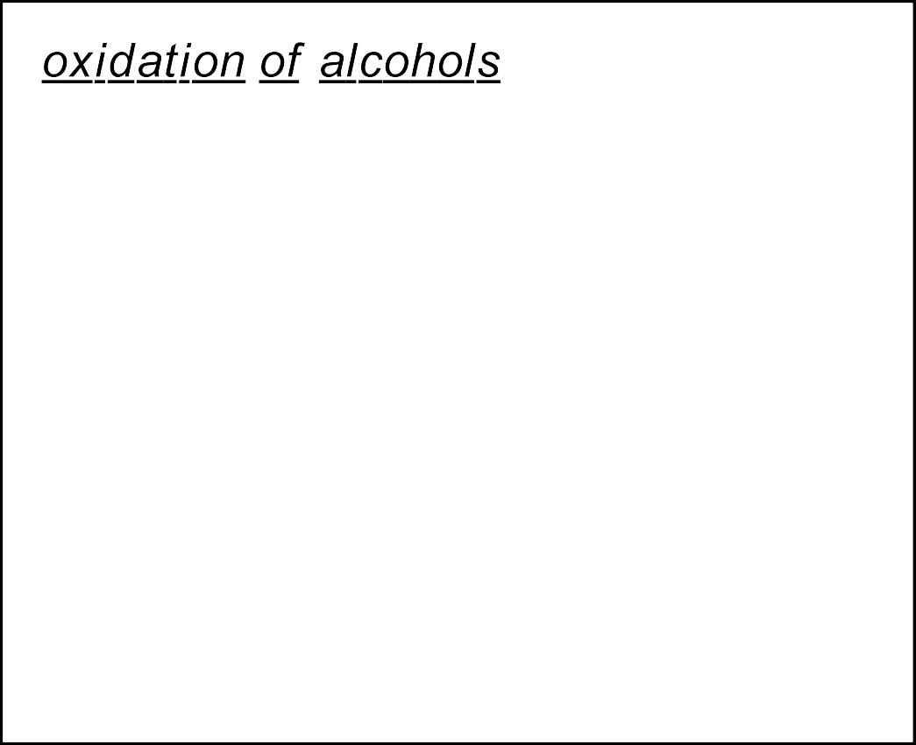

















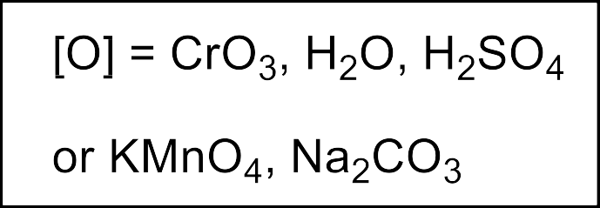






Preparation of acids (we will not see this topic
on this course)

Slide 17


Preparation of chlorides, esters, amides
Acyl nucleophilic substitution

Slide 18
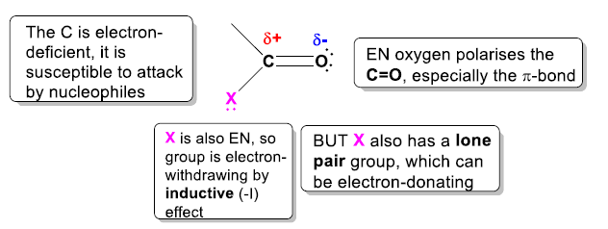






Reactivity: acyl nucleophilic substitution
As with the C=O group in aldehydes and ketones, the electron-deficient C of C=O is susceptible to attack by nucleophiles (the C=O bond is heavily polarised, with a relatively strong δ+ on the C and a δ- on the O)
But, the tetrahedral ‘product’ is itself unstable (so an intermediate) and reacts further
EN: electronegative

Slide 19
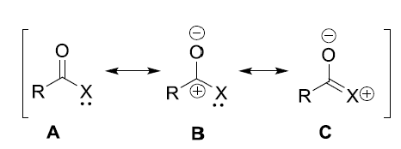
Explanation of Reactivity: acyl nucleophilic substitution
The reactivity of carboxylic acid derivatives (acyl chlorides, esters and amides) towards nucleophiles depend on how strong the δ+ on the Carbon is.
We can have a good idea about this by looking at the contributions to the actual structure of the resonance forms (r.f.) A, B and C. Especially
C. The more that C contributes, the less that B
contributes, therefore the less δ+ on the Carbon.
X=Cl: Cl moderately electronegative, Cl⁻ great leaving group, orbitals in Cl are too big to overlap effectively
with carbon, therefore, r.f. C is not too contributing: very high δ+ on carbon, weak C-Cl bond
X=NR2: N high electronegativity, R2N⁻ or even R2NH (if acid medium) not good leaving group, orbitals in N
are of right size, and orbitals in N can overlap well with carbon’s: r.f. C is very contributing, not very high δ+
on carbon, strong C-N bond
X=OR: in between the two: O very high electronegativity, RO⁻ not a good leaving group, but even ROH is
good leaving group (acid medium), similar orbitals with carbon: r.f. C is contributing but less than for amides,
intermediate δ+ on carbon, intermediate strength C-O bond

Slide 20
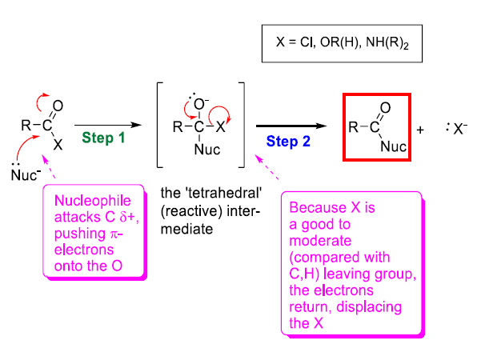
Reactivity: acyl nucleophilic substitution mechanism
Step 1. Attack of nucleophile to
give ‘tetrahedral intermediate’.
Step 2. re-formation of the C=O with expulsion of the original
group X (X = OH, OR’, Cl, NR’R”
The product is itself a C=O compound and MAY react further

Slide 21


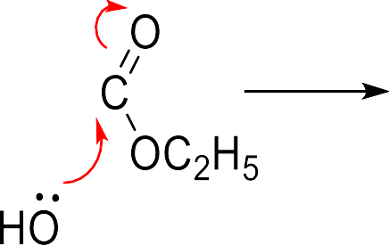








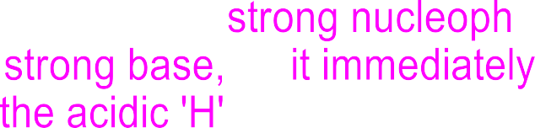



Reactivity: acyl nucleophilic substitution
Alkaline hydrolysis of an ester

Slide 22
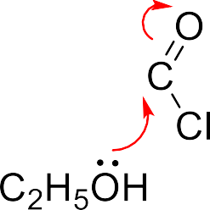












Reactivity: acyl nucleophilic substitution
Ester from acid chloride

Slide 23
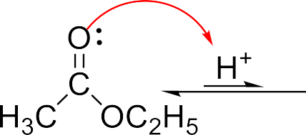
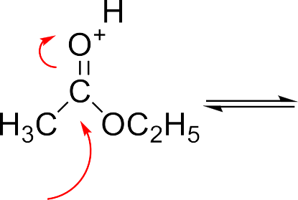
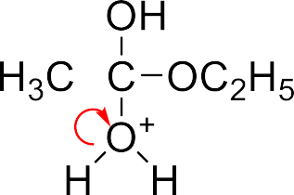
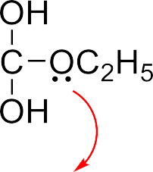
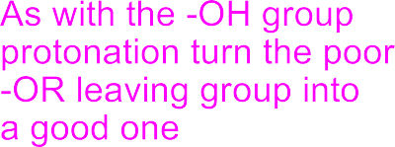


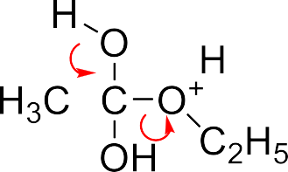



Acid-catalysed substitution
The C=O can be activated towards weak nucleophiles by pre-protonation by strong acid which enhances the polarity of the C=O
Cleavage of an ester by water is called hydrolysis
The reaction is reversible, ester in acidic water solvent reacts to carboxylic acid, while the
acid in acidic alcohol reacts to give ester

Slide 24
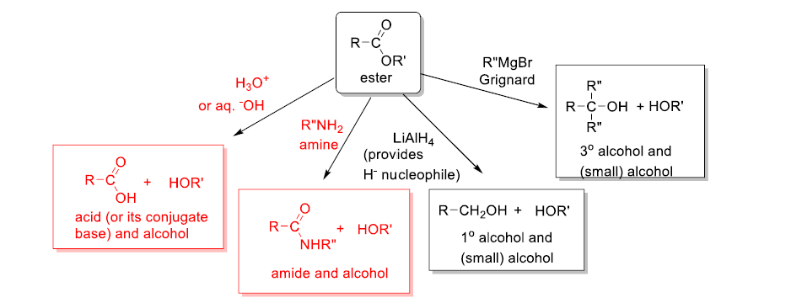
Scope of nucleophilic substitution
A wide range of nucleophiles can be used to provide a range of products; examples are shown for the ester

Slide 25

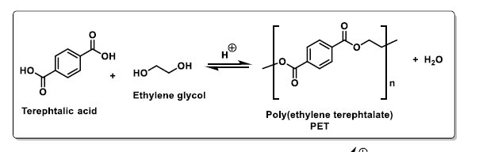
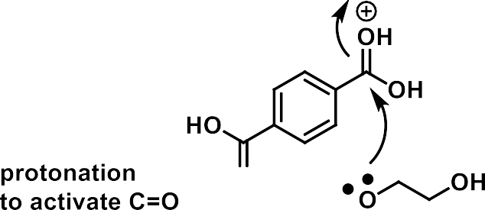
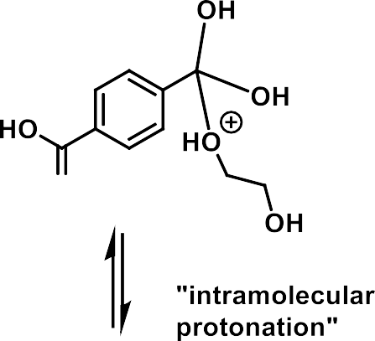

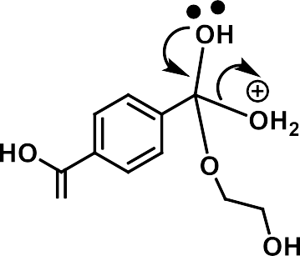

Formation of Polyesters
Classical Fischer esterification
(Fischer esterification: RCOOH, R’OH,
H₂SO₄ catalyst)

Slide 26



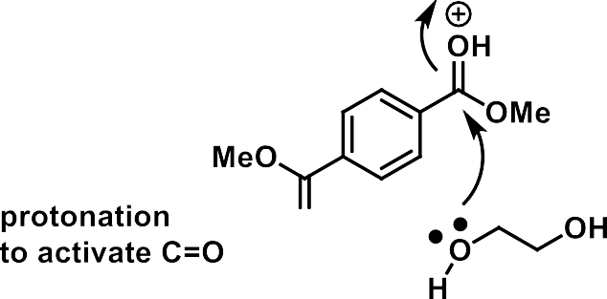
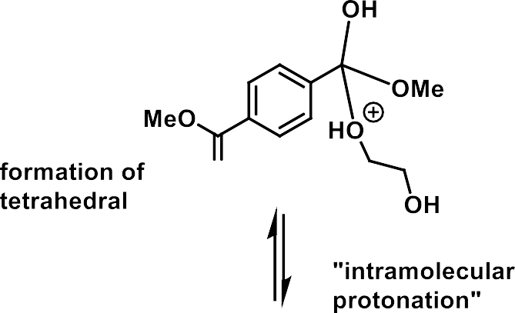


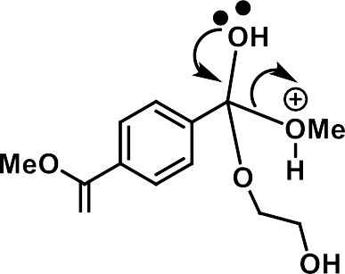



Formation of Polyesters
Transesterification: easier to remove MeOH than H₂O (lower boiling point, and also ester more reactive than carboxylic acid): Commercial route to PET

Slide 27

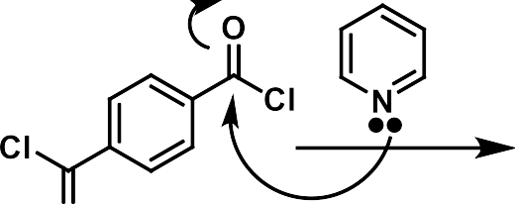
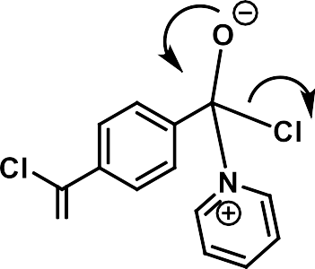
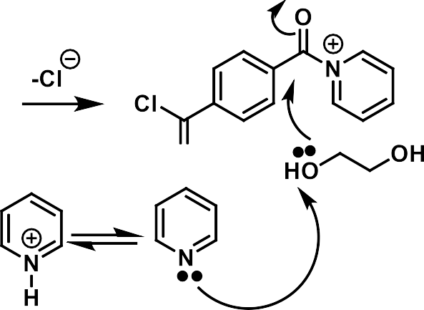
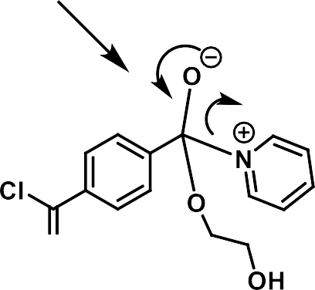
Formation of Polyesters
Acid chlorides: possible, but less used for polyesters.

Slide 28
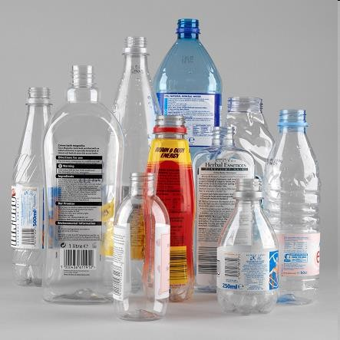

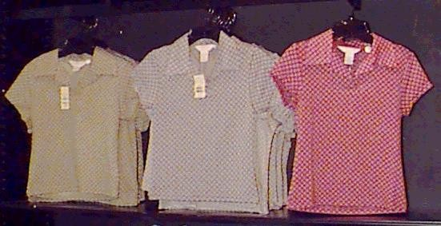
PET: thermoplastic and fibers and metalised film (high resistance, low permeability)
Polyester

Slide 29













Formation of Polyamides
?
Carboxylate not electrophilic and
ammonium ions non nucleophilic

Slide 30







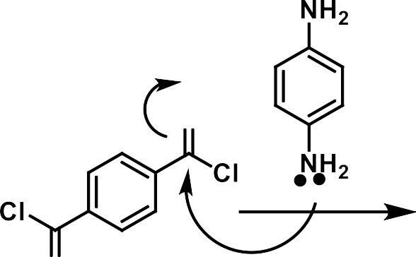
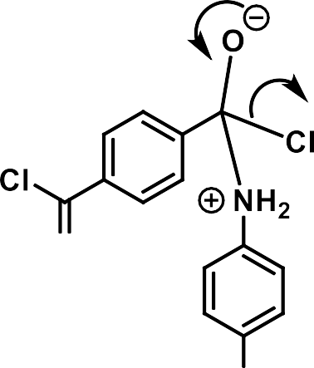




Formation of Polyamides

Slide 31
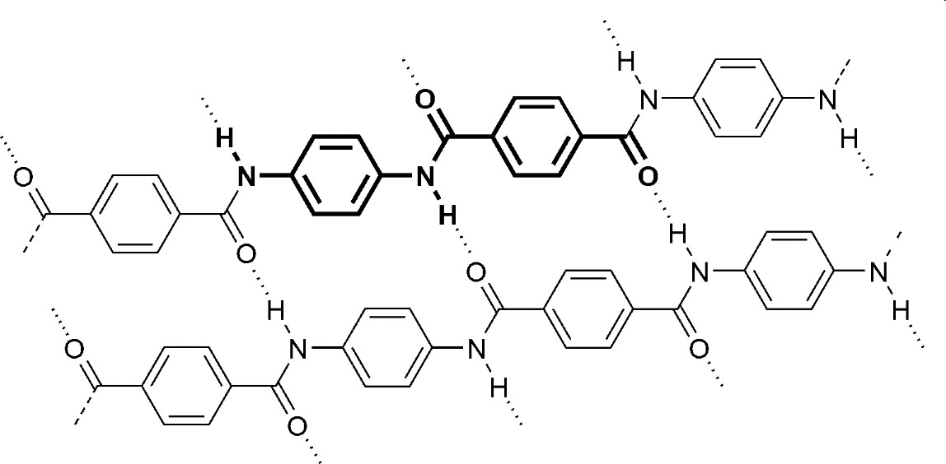

ARAMIDES (aromatic polyamides): (KEVLAR) : STRONG FIBERS
(H-Bonding + strong π-π interactions
between chains)
Bullet proof vests, high performance materials

Slide 32
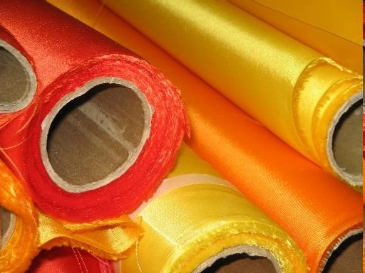


Nylons: aliphatic polyamides: fibres (H-Bonding between
chains): originally proposed as alternatives to silk
Nylon

